Slide 1
Utilizing Logistics Regression and Decision Tree Model to Predict Customer Churn for a Telecommunication Company
Group # Names : - A - B - C - D

Slide 2
Introduction
Customer churn is a vital issue in every industries.
Churning customers will reduce the overall customer lifetime value.
It will increase customer acquisition costs.
Companies in telecommunication industry can have an average annual churn rate to be as high as 67% (Hughes).
For telecommunication companies, 75% of the new customers are churners of other companies (Hughes).
Preventing churn can save millions of dollars, and hence predicting churn before it happens is crucial.

Slide 3
Project Target
Split the data into a training set, which the model will be built from, and a test set, which will be utilized to test the model’s accuracy.
Create a logistic regression model to predict customer churn.
Create decision tree model to predict customer churn.
Try to build another model using only significant variables.
Compare the models and determine which model gave the more accurate result, with the least variance.

Slide 4
Data Overview
The data for the case consists of 2,114 observations with 14 variables
Most of the variables are nominal data with character data type.
There are two missing values in TotalCharges. Both are eliminated.
Convert categorical variables as factor, and convert value 1 and 0 as “yes” and “no” in SeniorCitizen variable.
Notes:
The 14 variables are
customerID: unique customer identifier
gender: gender of customer,
SeniorCitizen: indicates if a customer is a senior citizen (1) or not (0)
Partner: Indicates if the customer has a partner (Yes) or not (No)
Dependents: Indicates if the customer has dependents (Yes) or not (No)
tenure: the length of time that the customer has been a customer
PhoneService: Indicates if the customer has phone service with the company (Yes) or not (No)
InternetService: Indicates if the customer has fiber optic, DSL or no internet service with the company
Contract: The type of contract that the customer has with the company (Month-to-month, One year, Two year)
PaperlessBilling: If the customer is enrolled in paperless billing (Yes) or not (No)
PaymentMethod: The most recent payment method used by the customer to pay the company (Electronic check, Mailed check, Bank transfer (automatic), or Credit card (automatic)
MonthlyCharges: The most recent amount that the customer is charged per month
TotalCharges: The total amount that the customer has been charged
Churn: Whether the customer has left the company (Yes) or not (No)
The two missing value observations in TotalCharges can be considered insignificant compared to the total of 2,114 observations, so the analysis will eliminate both and get the total of 2,112 observations.

Slide 5
Data overview after cleaning and pre-processing
Notes:
Eliminate unnecessary variables: the customerID.
With 2 records eliminated, the project will analyze 2,112 observations, using 13 variables (12 predictor variables to predict the target variable Churn).

Slide 6
Exploratory Data Analysis (EDA)
The EDA will be executed for categorical variables first and then numerical variables.
For categorical variables, the EDA will provide bar graphs for each variable and with an overlay to target variable Churn, its normalized view and Contingency tables.
For numerical variables, the descriptive statistics will be provided along with a histogram that shows how the variables may relate to Churn. The project will also examine the correlation between these numerical variables.

Slide 7
EDA for Categorical Variables
Notes:
This is the example of what we did in EDA for categorical variables. In this slide, the EDA is about variable Contract.
In this variable, customers with a month-to-month contract may have a higher chance of churning, compared to one year and two years contract. It can be shown by the overlay bar graph and contingency table.
While the dataset has more observations for month-to-month contracts (look at first graph), the normalized bar graph still shows that almost half of the customers with a month-to-month contract have churned (look at second graph). It can be understood logically that customers with a month-to-month contract have lower switching costs to leave the company’s service and choose another company. It makes the decision to churn easier for these customers compared to those with one-year or two-year contracts. This logical reasoning can become initial proof that the difference is not due to random chances.
Execute the same analysis for each variable, obtain a bar graph overlay for each variable related to Churn, the normalized bar graph, and the contingency table, which are shown in Appendix 1 in the report document. Using these graphs, EDA can see some potential variables to predict Churn, such as InternetService and PaymentMethod. There are also variables showing only moderate differences, such as SeniorCitizen, Partner, Dependent, and PaperlessBilling. While variable gender and PhoneService may not provide significant differences in Churn. The logistic regression will have a deeper analysis of how the variable Contract may or may not be useful to predict Churn.

Slide 8
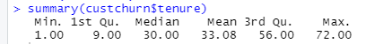
EDA for Numerical Variables
Notes:
The histogram overlay and the normalized version can provide a preliminary analysis of how each numerical variable may influence Churn. For instance, this slide shows histogram overlay for variable tenure and its normalized version.
By default, R divides the histogram into 30 bins. While there are a different number of observations in each bin, the normalized version of the histogram shows that customers with shorter tenure have a higher chance to churn. It is logical that customers who perceive the company’s service positively will stay in the company’s service for a longer time, and hence they have a lower churn rate. Newer customers may find other companies' offers more appealing and look at the churn decision as easier than older customers. This logical reasoning can become initial proof that the difference is not due to random chances.
Histograms for two other numerical variables are shown in Appendix 2 in the report document, along with the summary of the data. Both histograms show that the other two numerical variables MonthlyCharges and TotalCharges may not be as significant as variable tenure. The logistic regression will have a deeper analysis of how each of these numerical variables may or may not be useful to predict Churn.
Aside from how each numerical variable relates to churn, a correlation between these numerical variables can also be examined to better understand the data. Logically, tenure and TotalCharges should have a strong positive association, since customers with longer tenure paid more cumulatively than those with shorter tenure. The correlation for each variable can be shown through the correlation matrix below.

Slide 9
Data Partition
Both techniques logistic regression and decision tree are supervised methods.
It means that the model should be trained using training dataset and tested for the accuracy using training dataset
Thus, the program should divide the dataset into a training dataset and a testing dataset.
Using R, the data partition will be created using random seed value 1027.
Notes:
the data partition will be created using random seed value 1027 so that users of the model can recreate the result.
1027 is the birthday date.

Slide 10
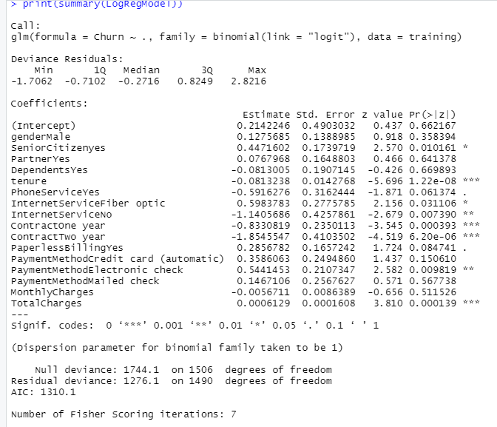
Logistic Regression 1st Model
Notes:
The coefficients table shows the coefficient for each variable, as well as its standard error, z value, and p-value. The stars at the end of each row depict the significance of the variables. Variables with three stars have higher significance than variables with two or lower numbers of stars. The analysis found that there are various significant variables, such as tenure, internet service, contract, payment method, and total charges. Almost all of these variables have a significant coefficient estimate value and lower than a 0.05 p-value which means that it is statistically significant. Variable total charges have lower estimate value since the variable contains large numerical values (further analysis can standardize variables with large numerical values for a better depiction of their significance).

Slide 11
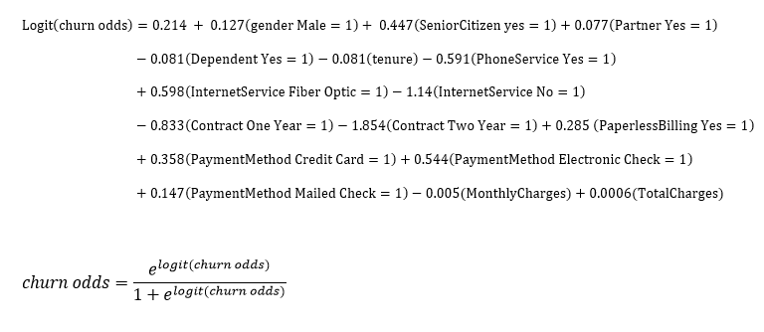
Logistic Regression 1st Model
Notes:
This is the logit equation derived from the result earlier. The estimate is the coefficient in the linear logit odds function. The churn odds can be obtained by solving the equation.

Slide 12
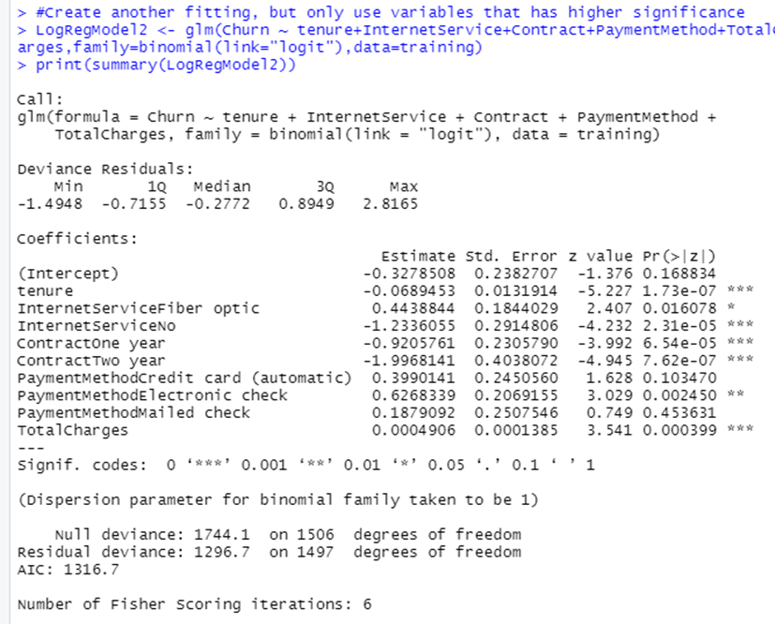
Logistic Regression 2nd Model
Notes:
The model will use five variables that are the most significant from the first model, which are tenure, InternetService, Contract, PaymentMethod, and TotalCharges.
Notice that most of the variables are statistically significant with a p-value less than 0.05. Using the same analysis as the previous model, the linear logit equation can be written using the estimated value above as the coefficient for each variable.

Slide 13
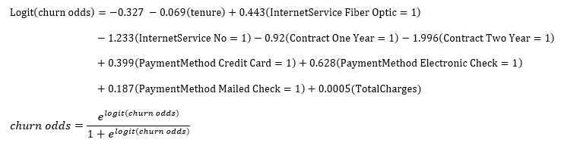
Logistic Regression 2nd Model
The second model is simpler, since it uses fewer variables
The model only focuses on variables with significant influence on Churn, which are found as insight from the first model
Both model have similar insight, noting that the most important variables are Contract, tenure, InternetService, PaymentMethod, MonthlyCharges, and Total Charges
Notes:
This is the logit equation derived from the result of the second logistic regression model. The estimate is the coefficient in the linear logit odds function. The churn odds can be obtained by solving the equation.
ANOVA of the first and second model shows that the second model is significantly better in modelling the training dataset, with p value less than 0.05.

Slide 14
Model Accuracy
Test the first and second model using testing dataset
Create confusion matrix and calculate the model accuracy
For the first model, the accuracy is 0.809 while for the second model, the accuracy is 0.803.
The matrix shows that the first model accurately predicts 412 cases of not churning and 78 cases of churning customers. the first model accuracy is 0.809 = (412+78)/(412+78+32+83). Using the second confusion matrix, the accuracy value for the second model is of 0.803.
Model 1 Confusion matrix |  | Predicted data
 |  | No | Yes
Actual data | No | 412 | 32
 | Yes | 83 | 78
Model 2 Confusion matrix |  | Predicted data
 |  | No | Yes
Actual data | No | 407 | 37
 | Yes | 82 | 79
Notes:
The accuracy of the first and second models above can be tested using the test dataset. Using R, the test will use variable values of each customer in the test dataset and predict whether the customer will churn or not. Then, the program will compare the prediction and the actual data to determine the accuracy level of the model.
For example, the first observation in the test dataset is a female with no partner, no dependents, and not a senior citizen, also with a tenure of 8 months, using phone services, fiber optic internet service, and month-to-month contract, using paperless billing, have an electric check as a payment method, with 99.65 monthly charges, and 820.5 total charges. Using these data as an input for the first model, the odd of the customer churning can be written as follow.
$$Logit\left(churn odds\right)=0.214 + 0.127\left(0\right)+ 0.447\left(0\right)+0.077\left(0\right)−0.081\left(0\right)−0.081\left(8\right)−0.591\left(1\right)+0.598\left(1\right)−1.14\left(0\right)−0.833\left(0\right)−1.85\left(0\right)+0.285 \left(1\right)+0.358\left(0\right)+0.544\left(1\right)+0.147\left(0\right)−0.005\left(99.65\right)+0.0006\left(820.5\right)=0.214−0.081\left(8\right)−0.591+0.598+0.285+0.544−0.005\left(99.65\right)+0.0006\left(820.5\right)=0.396$$
$$churn odds=\frac{e^{0.396}}{1+e^{0.396}}≈0.6$$
The model predicts that the customer has a 0.6 chance of churning. Using 0.5 as a threshold, the model will classify this customer as churning and put “Yes” in the prediction. The testing dataset already has the churn data of the customer, and it turns out that the customer has churned. Therefore, in this case, the model predicted the right outcome for the customers.
Iterating this process for each customer in the testing dataset, the program will get the overall accuracy of the model. For the first model, the accuracy is 0.809 while for the second model, the accuracy is 0.803. The confusion matrix for both models is shown above.
The result shows that the first model did a slightly better job in predicting the test dataset. While the second model is better in terms of variance of the training dataset, its performance is not better than the first model. However, the difference is small. Hence, the project may choose either model since both have a similar level of accuracy. For this project, the chosen model will be the second model, since it provides a simpler model using fewer variables that are proven significant. Providing a larger dataset to test can be a good way to show which model is better in accurately predicting customer churn.

Slide 15
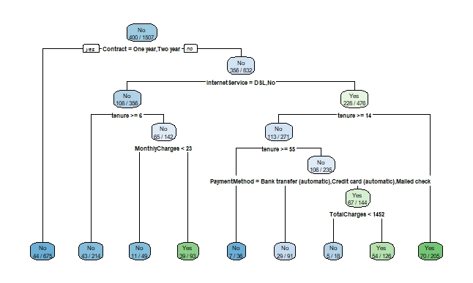
Decision Tree
Notes:
Using R, the decision tree can be established from the training dataset. The result of the decision tree diagram can be shown on the slide. The root node used the variable Contract, which means that the variable is the most important one in predicting customer churn. If a customer has one year or two years contract, the model will directly categorize the customer as not churning. While for customers with a month-to-month contract, the decision should be followed by the next branch, which is InternetService, and then tenure.
The model consists of 9 leaf nodes and 7 branch nodes. Note that the model only uses 6 variables out of the 12 variables in the dataset. Here, the most important variables to predict churn are Contract, InternetService, tenure, MonthlyCharges, PaymentMethod, and TotalCharges. This result is similarly consistent with the second model of the logistic regression model which only uses the same 5 most important variables. Only here does it includes variable MonthlyCharges.

Slide 16
Model Accuracy
Test the first and second model using testing dataset
Create confusion matrix and calculate the model accuracy
The decision tree model accurately predicts 384 cases of not churning and 104 cases of churning customers.
Using the same calculation as above, the accuracy of this model is can be calculated as 0.806.
The decision tree model is proven to have a similar accuracy level to the logistic regression model with about 80% accuracy.
Decision Tree Confusion matrix |  | Predicted data
 |  | No | Yes
Actual data | No | 384 | 57
 | Yes | 60 | 104
Notes:
The accuracy of the first and second models above can be tested using the test dataset. Using R, the test will use variable values of each customer in the test dataset and predict whether the customer will churn or not. Then, the program will compare the prediction and the actual data to determine the accuracy level of the model.
For example, the first observation in the test dataset is a female with no partner, no dependents, and not a senior citizen, also with a tenure of 8 months, using phone services, fiber optic internet service, and month-to-month contract, using paperless billing, have an electric check as a payment method, with 99.65 monthly charges, and 820.5 total charges. Using these data as an input for the first model, the odd of the customer churning can be written as follow.
$$Logit\left(churn odds\right)=0.214 + 0.127\left(0\right)+ 0.447\left(0\right)+0.077\left(0\right)−0.081\left(0\right)−0.081\left(8\right)−0.591\left(1\right)+0.598\left(1\right)−1.14\left(0\right)−0.833\left(0\right)−1.85\left(0\right)+0.285 \left(1\right)+0.358\left(0\right)+0.544\left(1\right)+0.147\left(0\right)−0.005\left(99.65\right)+0.0006\left(820.5\right)=0.214−0.081\left(8\right)−0.591+0.598+0.285+0.544−0.005\left(99.65\right)+0.0006\left(820.5\right)=0.396$$
$$churn odds=\frac{e^{0.396}}{1+e^{0.396}}≈0.6$$
The model predicts that the customer has a 0.6 chance of churning. Using 0.5 as a threshold, the model will classify this customer as churning and put “Yes” in the prediction. The testing dataset already has the churn data of the customer, and it turns out that the customer has churned. Therefore, in this case, the model predicted the right outcome for the customers.
Iterating this process for each customer in the testing dataset, the program will get the overall accuracy of the model. For the first model, the accuracy is 0.809 while for the second model, the accuracy is 0.803. The confusion matrix for both models is shown above.
The result shows that the first model did a slightly better job in predicting the test dataset. While the second model is better in terms of variance of the training dataset, its performance is not better than the first model. However, the difference is small. Hence, the project may choose either model since both have a similar level of accuracy. For this project, the chosen model will be the second model, since it provides a simpler model using fewer variables that are proven significant. Providing a larger dataset to test can be a good way to show which model is better in accurately predicting customer churn.

Slide 17
Model Comparison
The first and second logistic regression models as well as the decision tree model have similar accuracy about 80%.
ANOVA shows that the second logistic regression model is significantly better than the first model, while also use fewer variables that are more important.
The decision tree is easy to understand and easy to execute. However, there are several limitations of the decision tree, such as oversimplifying relationship and having potential misinterpretation.
The logistic regression is more difficult to understand and it requires some statistical and mathematical knowledge to correctly interpret the result.
Notes:
The decision to choose which predictive model to use is determined by various criteria, such as the model’s accuracy, bias and variance, and ease of use. The first and second logistic regression models as well as the decision tree model have similar accuracy of 80%. However, ANOVA shows that the second logistic regression model is significantly better than the first model. It also uses fewer variables and focuses on the more important variables. Hence, the option is only between the second logistic regression model and the decision tree model.
The decision tree is relatively easier to understand and easier to execute. However, there are several limitations of the decision tree. The first is that it tends to oversimplify the impact of a variable. For instance, in this case, a customer with one year and two years contract will be directly categorized as not churning customer. In reality, customers with one-year and two years contracts should still have the probability of churning due to various other factors. The second limitation is that the decision tree may have potential misinterpretation, especially for variables with high correlation.
Meanwhile, the logistic regression is more difficult to understand and it requires some statistical and mathematical knowledge to correctly interpret the result. It can lead to wrong interpretation and causes an overall wrong model application. However, if it can be executed properly, it usually provides a better depiction of how a variable will influence the target variable.
Bock stated that for an academic study aiming to provide solid conclusions about a predictive model, logistic regression is typically better than a decision tree, but, if the goal is to describe the data or solely to create a prediction, then a decision tree is usually better. In this case, logistic regression can provide more insights for further study. Thus, the recommendation is to use the second logistic regression model. However, if the company has more computing power, it can keep both model, logistic regression, and decision tree for future prediction problems.

Slide 18
Discussion 1: Contract and Tenure
The longer the tenure of a customer, the less likely for the customer to churn.
The increase of one month in tenure will decrease to log odds of the customer churning by 0.069.
Customers with a month-to-month contract have 0.92 fewer log odds of churning compared to customers with one year contract, and 1.99 less when compared to customers with two years contract.
Focus on attempt to retain newer customers
Provide better incentives or programs that encourage customers to prompt for one year or two years contract, instead of month-to-month basis
Notes:
Contract and tenure
The most important variables in all models are related to how long the customers have used the company’s service. Customers with month-to-month contracts and shorter tenure tend to churn since they have low switching costs if they want to switch and use a competitor’s service. This issue will be increasingly vital in an industry with intense competition. Without a clear strategy, the company will fight and struggle for customer acquisition instead of customer retention.
From the second model of logistic regression, the increase of one month in tenure will decrease to log odds of the customer churning by 0.069. The longer the tenure of a customer, the less likely for the customer to churn. The second model also shows that customers with a month-to-month contract have -0.92 fewer log odds of churning compared to customers with one year contract, and -1.99 less likely when compared to customers with two years contract. This result points out the importance of managing newer customers so that they have a lower churn rate.

Slide 19
Discussion 2: Internet Service
Customers with DSL or no internet service tend to stay, compared to customers with fiber optic internet service.
Logically, customers with only phone service and DSL, without fiber optic internet service, may have no urgency to churn and use similar services from other companies.
The higher churn rate from the customers using fiber optic service may provide a sign that there are competitors with better fiber optic internet services.
The company may want to evaluate its fiber optic internet service and how it is perceived by the customers compared to similar services from the competitor. The company may also want to include the complaint rate in the dataset.
Notes:
Internet Service
Customers with DSL or no internet service tend to stay, compared to customers with fiber optic internet service. It is logical that customers with only phone service and DSL, without fiber optic internet service, may have no urgency to churn and use similar services from other companies. However, the higher churn rate from the customers using fiber optic service may provide a sign that there are competitors with better fiber optic internet services. The company may want to evaluate its fiber optic internet service and how it is perceived by the customers compared to similar services from the competitor. The company may also want to include the complaint rate in the dataset.
Payment Method
It is not surprising that customers’ payment method is also considered a significant factor in the model. The EDA process found out that the company has more customers with the electronic check payment method. It is an alarm for the company that customers with electronic check payment methods have a higher chance of churning compared to customers with other payment methods. Typically, electronic check payment is relatively less expensive than other payment methods (Kagan). Thus, customers with electronic check payment methods will also have lower switching costs to jump over to competitors’ services. The company may also want to provide a better payment experience or encourage customers to use other payment methods.

Slide 20
Discussion 3: Payment Method
Payment method is also considered a significant factor in the model.
The EDA process found out that the company has more customers with the electronic check payment method.
Customers with electronic check payment methods have a higher chance of churning compared to customers with other payment methods.
Typically, electronic check payment is relatively less expensive than other payment methods (Kagan).
Customers with electronic check payment methods will also have lower switching costs to jump over to competitors’ services.
The company may want to provide a better payment experience or encourage customers to use other payment methods.

Slide 21
Conclusion & Recommendation
Give more focus on the customers with shorter contracts and tenure, and how to make them stay longer.
Focus on customers with fiber optic internet service and electronic check payment methods. Increase the internet service quality and encourage customers to use other payment method.
Use the second model of logistic regression to predict customer churn until a better model can be developed.
Marketing and customer relationship management can be more efficient by only targeting predicted churning customers
Increase the quality of the model by adding more data or consider using more sophisticated machine learning techniques to better predict churn.
Notes:
The first recommendation is for the company to give more focus on the customers with shorter contracts and tenure. The company can create a strong marketing campaign that can encourage newer customers to stay in the company’s services for a longer period of time. The company can also provide better incentives that can encourage customers to switch from a month-to-month contract to one year or two years contract. The incentive can be provided as a charge discount or free additional services. The company should strengthen its competitive advantage so that it can have a strong position in the industry, instilling the perception of higher switching costs.
The second recommendation is to focus on customers with fiber optic internet service and electronic check payment methods. The churn rate of the customers with fiber optic internet is high, which may signal that the company’s fiber optic internet service may not the best in the industry. The company can also encourage customers to switch from electronic checks, credit cards, and mailed check payment methods to automatic bank transfers which will result in the lowest coefficient for InternetService variable. Evaluating customers' experiences related to these two variables is essential.
The next recommendation is to use the second model of logistic regression to predict customer churn until a better model can be developed. The model uses fewer variables than other models, and hence it involves simpler calculations. It is better than the decision tree model in depicting the reality of variable impact to churn variable. However, the company should take extra care and provide thorough calculations in establishing the model, since the technique is more difficult to interpret and prone to mistakes.
Another recommendation is to increase the quality of the model by adding more data into the training and testing data set. The company can also consider using more sophisticated machine learning techniques to better predict churn. Nevertheless, with an accuracy as high as 80%, the model established in this project is sufficient.

Slide 22
References
Bock, Tim. “Decision Trees Are Usually Better Than Logistic Regression.” Displayr, 9 June 2021, www.displayr.com/decision-trees-are-usually-better-than-logistic-regression
Hughes, A. “Churn Reduction in the Telecom Industry.” Database Marketing Institute, Mar. 2010, www.dbmarketing.com/2010/03/churn-reduction-in-the-telecom-industry.
Kagan, Julia. “Electronic Checks: Understanding the Basics.” Investopedia, 19 May 2020, www.investopedia.com/terms/e/electroniccheck.asp.

